Slide 1

Classifying brands on Facebook using supervised machine learning
General Assembly DSI : Capstone Project
by Sam Ho
sam@samho.co.uk

Slide 2
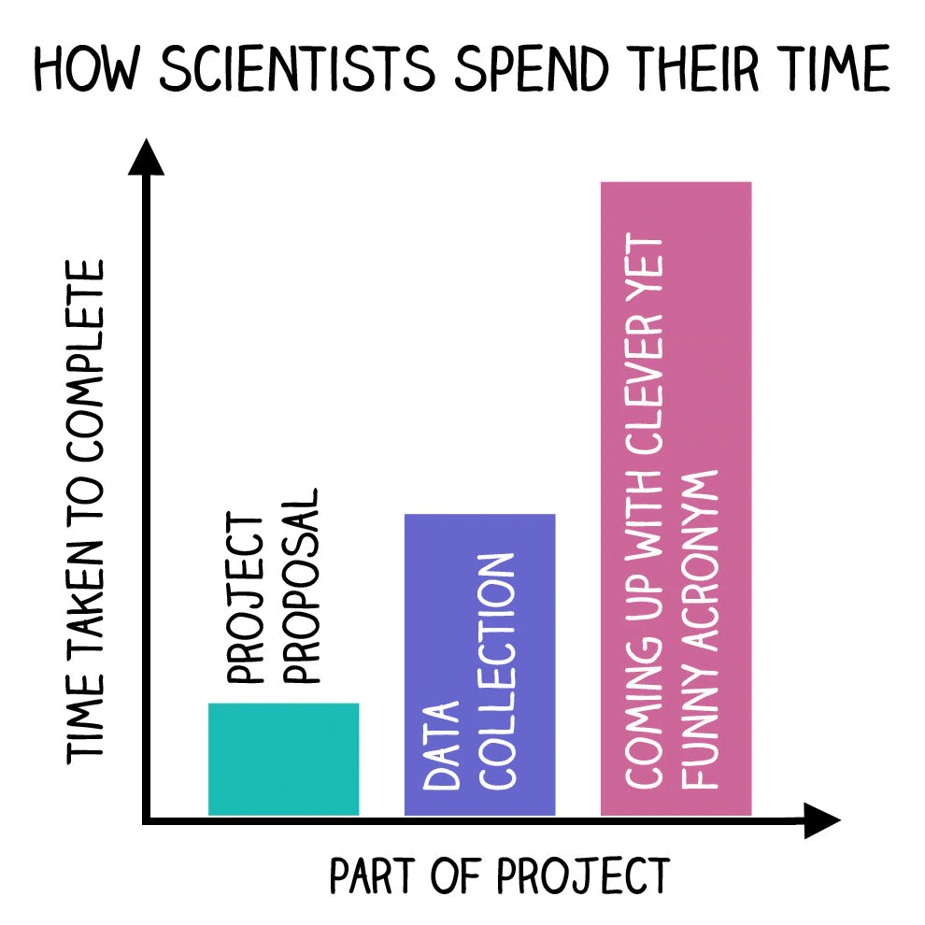
The Agenda : ‘CADET’
Context
Aims
Data
EDA | Modelling
Implications

Slide 3

CONTEXT

Slide 4
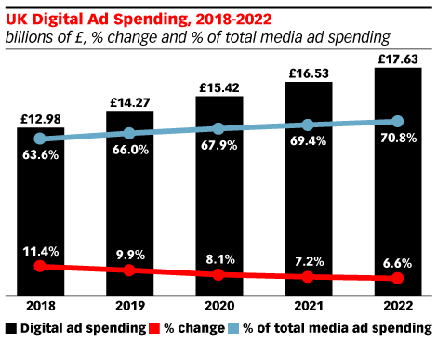
In 2018, almost two thirds of all advertising spend was on digital
https://www.emarketer.com/content/more-than-60-of-uk-media-ad-spending-is-digital
Notes:
Includes all formats – PPC, paid and social

Slide 5
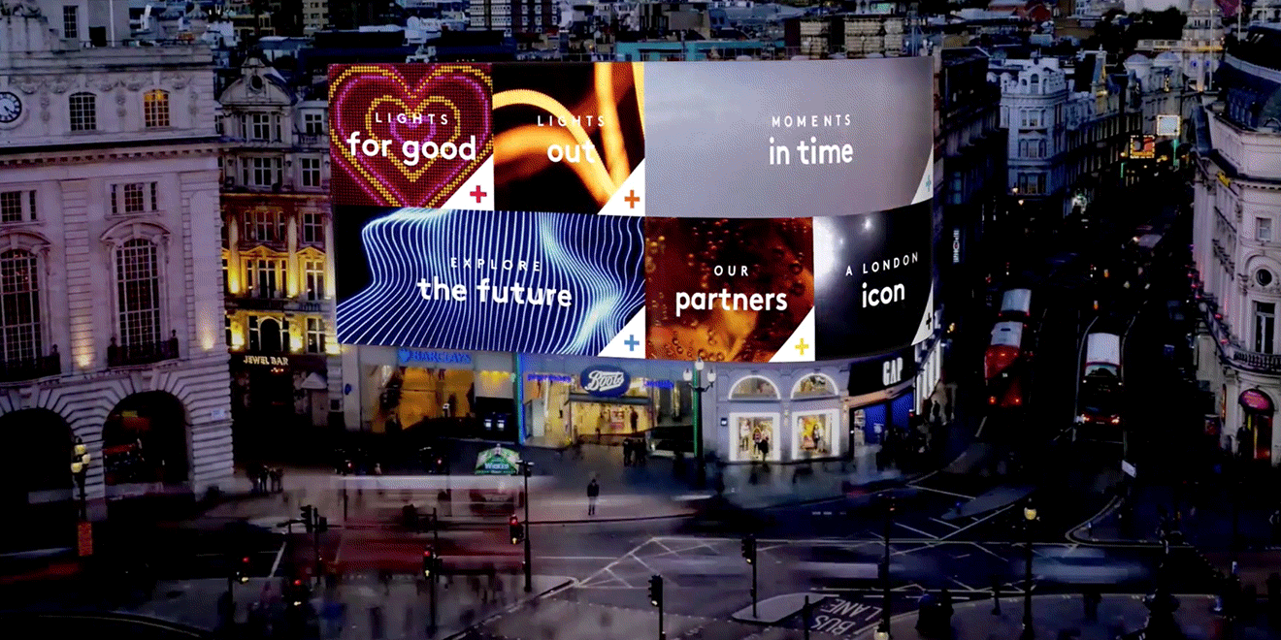
Why does this matter?
More spend =
…more content
…more noise
Increasing pressure to
…stand out
…to differentiate

Slide 6

AIMS

Slide 7

What do we want to find out?
Are brands doing enough to ensure their Facebook content is sufficiently differentiated?

Slide 8

How do we use Data Science to answer this?
Can we make a robot smart enough to be able to tell the difference between brands on Facebook?*
*Can we use supervised machine learning to allow us to classify different brand content on Facebook?

Slide 9

DATA

Slide 10






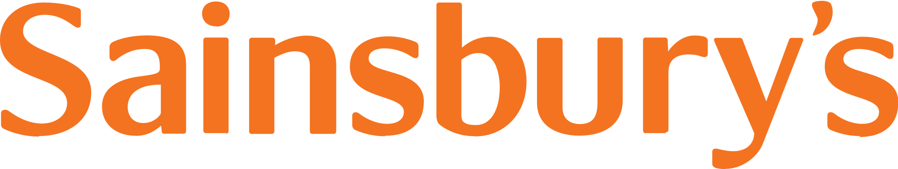

One category, seven brands
Higher End / Premium
Lower End / Budget
All on Facebook. All posting consistently. All with some purpose.

Slide 11


Two main data streams followed by feature engineering
Primary
data stream & features
Secondary
data stream & features
Engineered
features
Selenium
Dashboard CSV output
Python / Pandas
Vectorised Post Content
Contains_Link
Contains_Video
Has_Hashtag
Hashtag_Count
Post Content
#Responses
#Comments
#Shares
#Video views
Response_Rate Comments_Rate
Shares_Rate
Video_Rate
# Page Likes
(by date)
The key feature for classification modelling

Slide 12
6350 social media posts were scraped

Slide 13
Classes were mostly balanced
870 posts
(0.13)
777 posts
(0.12)
714 posts
(0.11)
1068 posts
(0.16)
770 posts
(0.12)
798 posts
(0.12)
1353 posts
(0.21)
Our baseline is 0.21 – our dominant class. If we can build a model that can score higher than this, then we can reject the null hypothesis and concede that there are genuine differences in the content produced by our brands

Slide 14
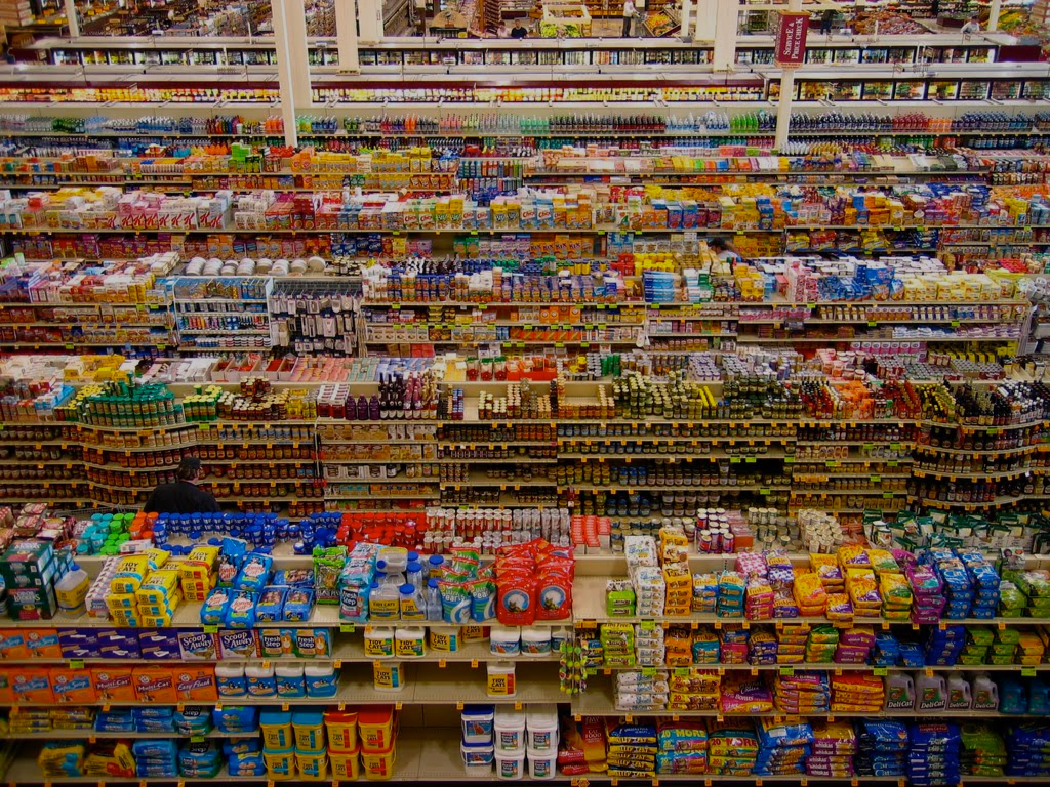
Unsurprisingly, our branded content was full of…branding
This makes things far too easy for a model to learn from

Slide 15

We need to do some cleaning up

Slide 16
How?
Extensive & bespoke
‘stop word’ lists
Lots and lots of regular expressions

Slide 17

Remove all ‘hard’ branding cues : specific mentions of a brand

Slide 18
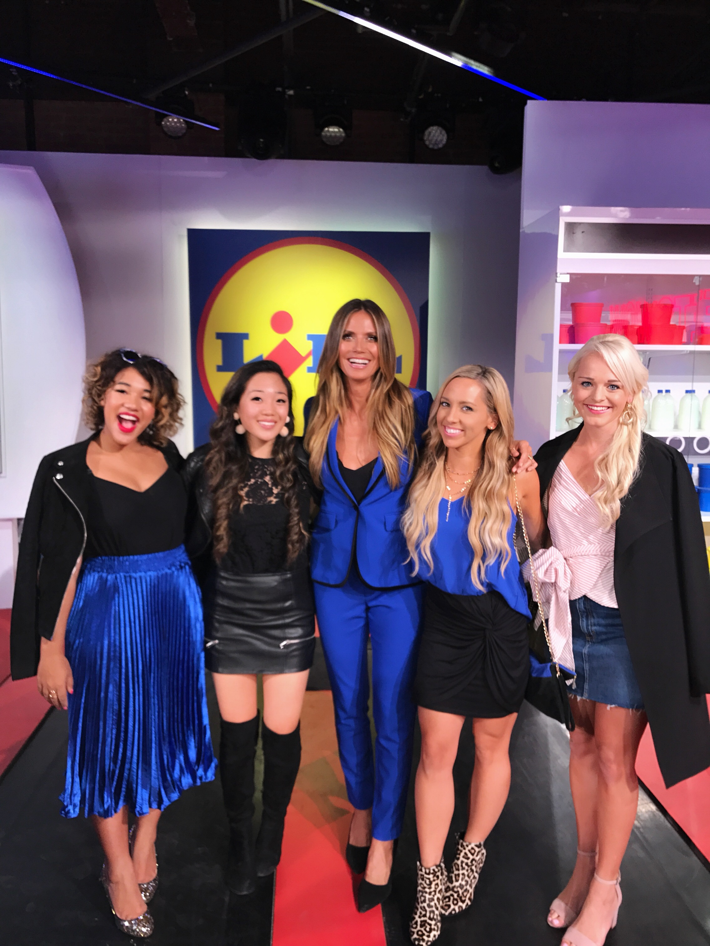


Remove all ‘soft’ branding cues : celebrity endorsements

Slide 19
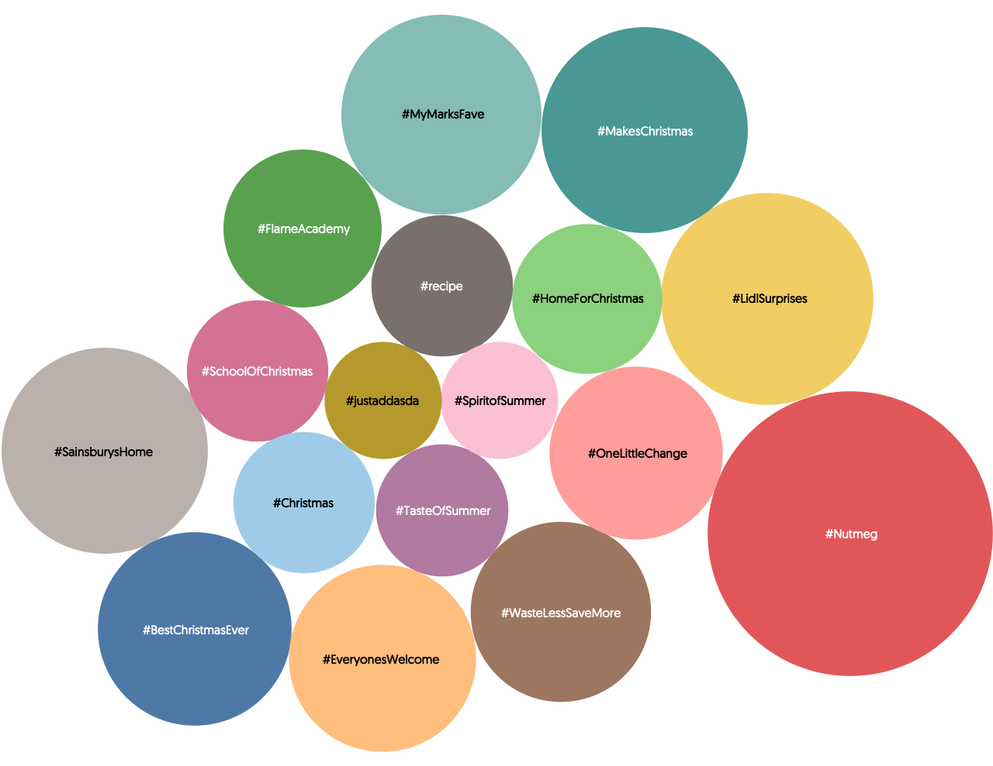
Remove all ‘soft’ branding cues : hashtags

Slide 20

All we want left is the narrative

Slide 21
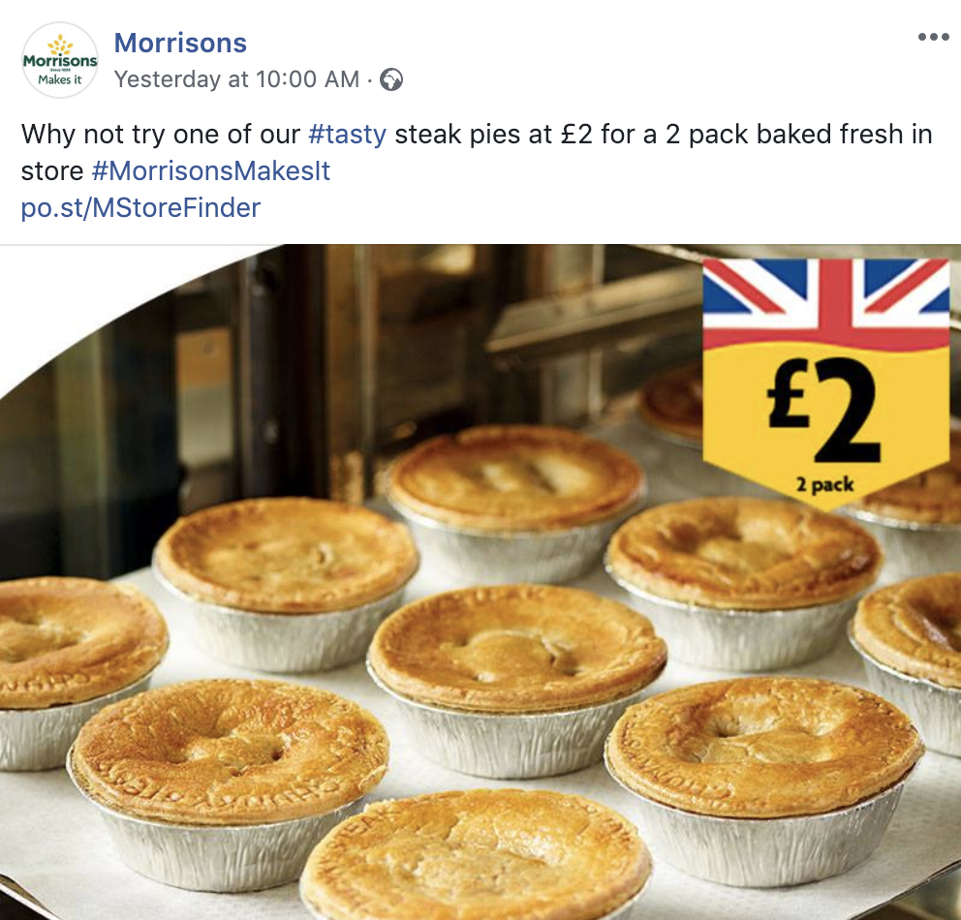
All we want left is the narrative

Slide 22
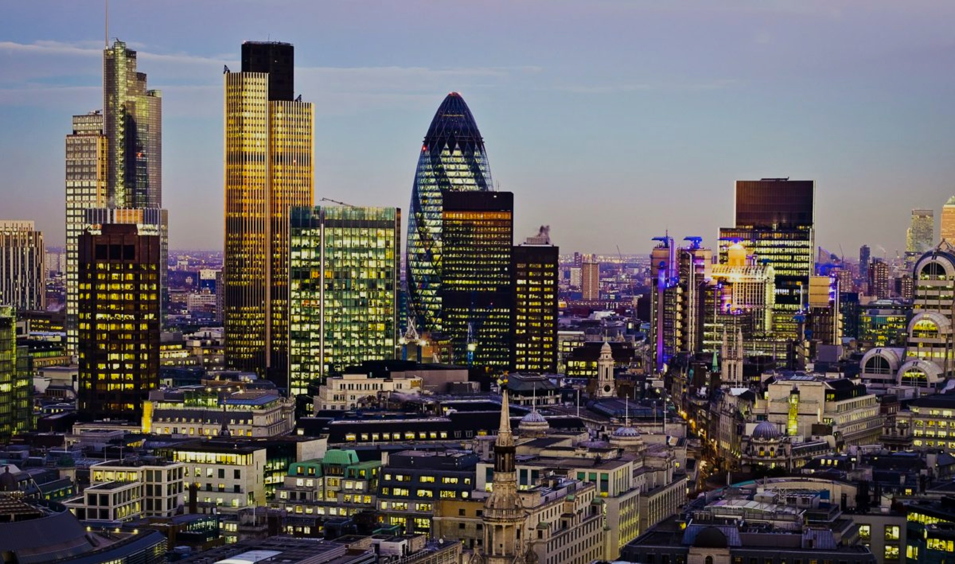
EDA & MODELLING

Slide 23
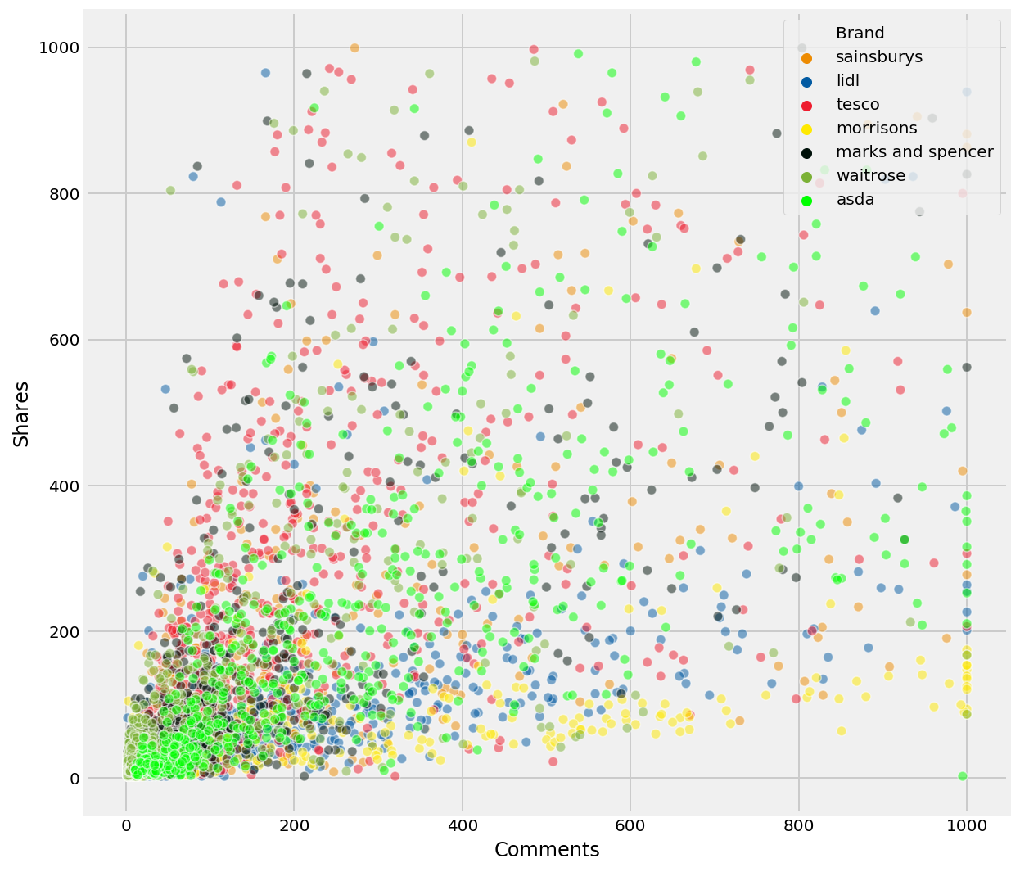
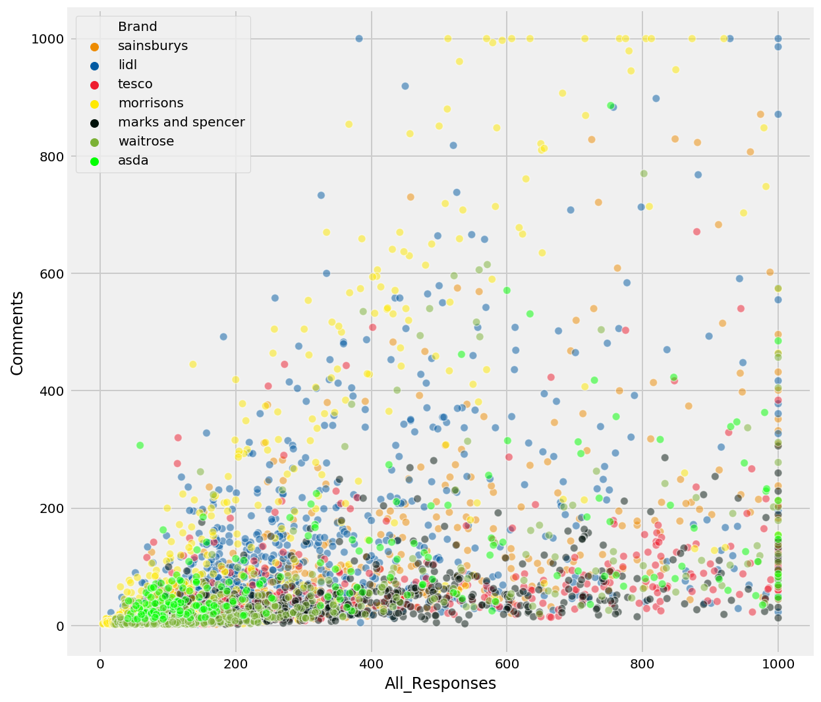
Engagement metrics aren’t correlated strongly
r=0.36
r=0.38
i.e. if a post gets a lot of comments, it doesn’t necessarily get a lot of shares

Slide 24
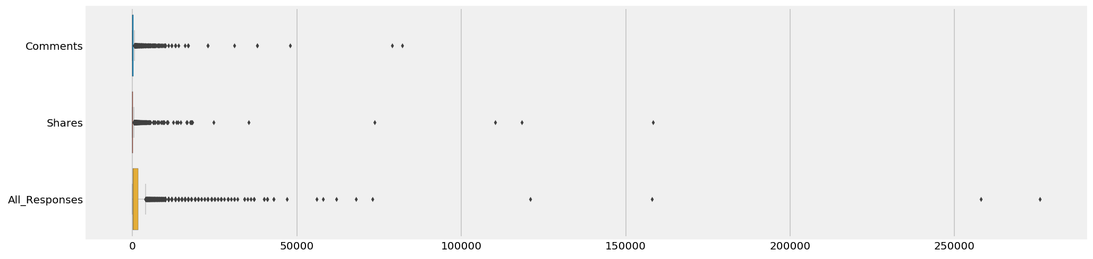
Engagement metrics are prone to outliers*
*posts that were very popular, receiving an unusually high number of shares, comments and responses

Slide 25
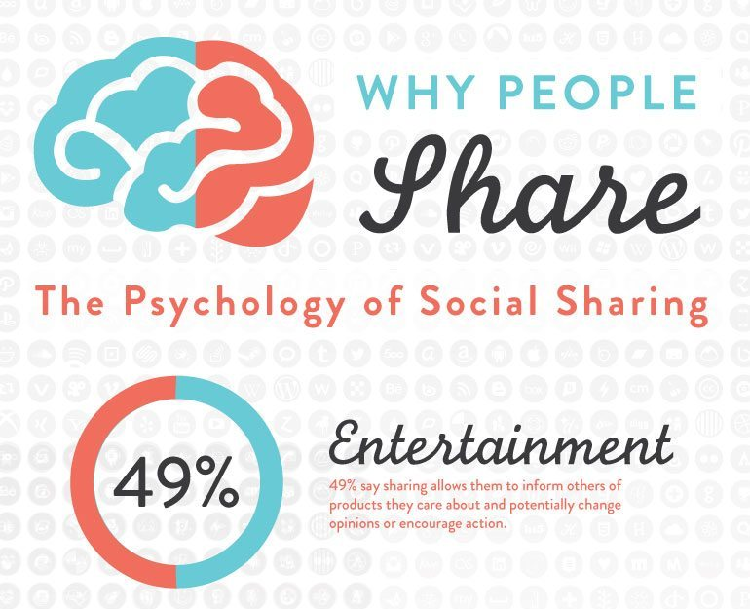
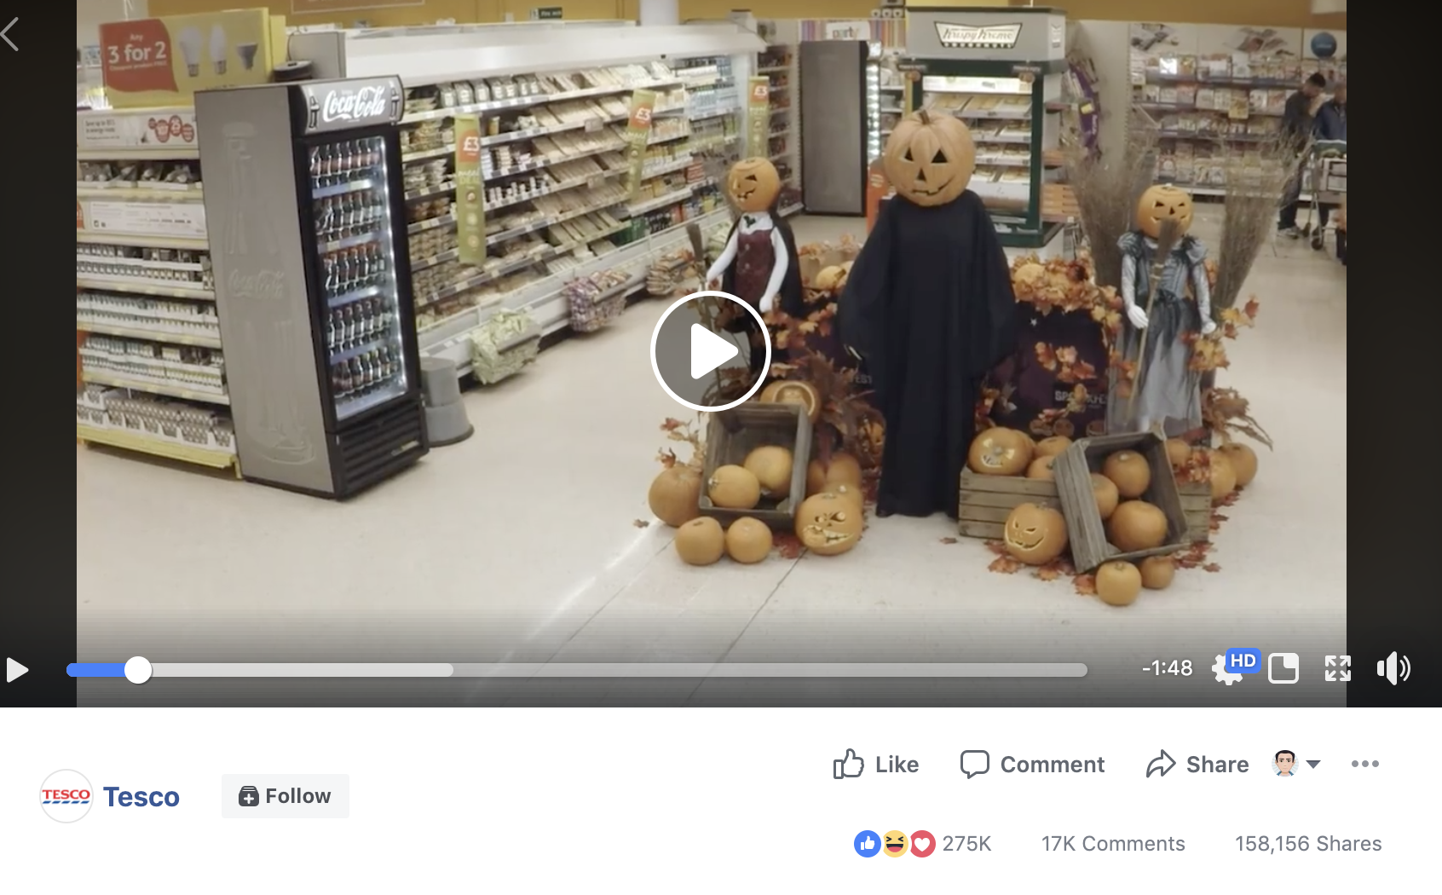
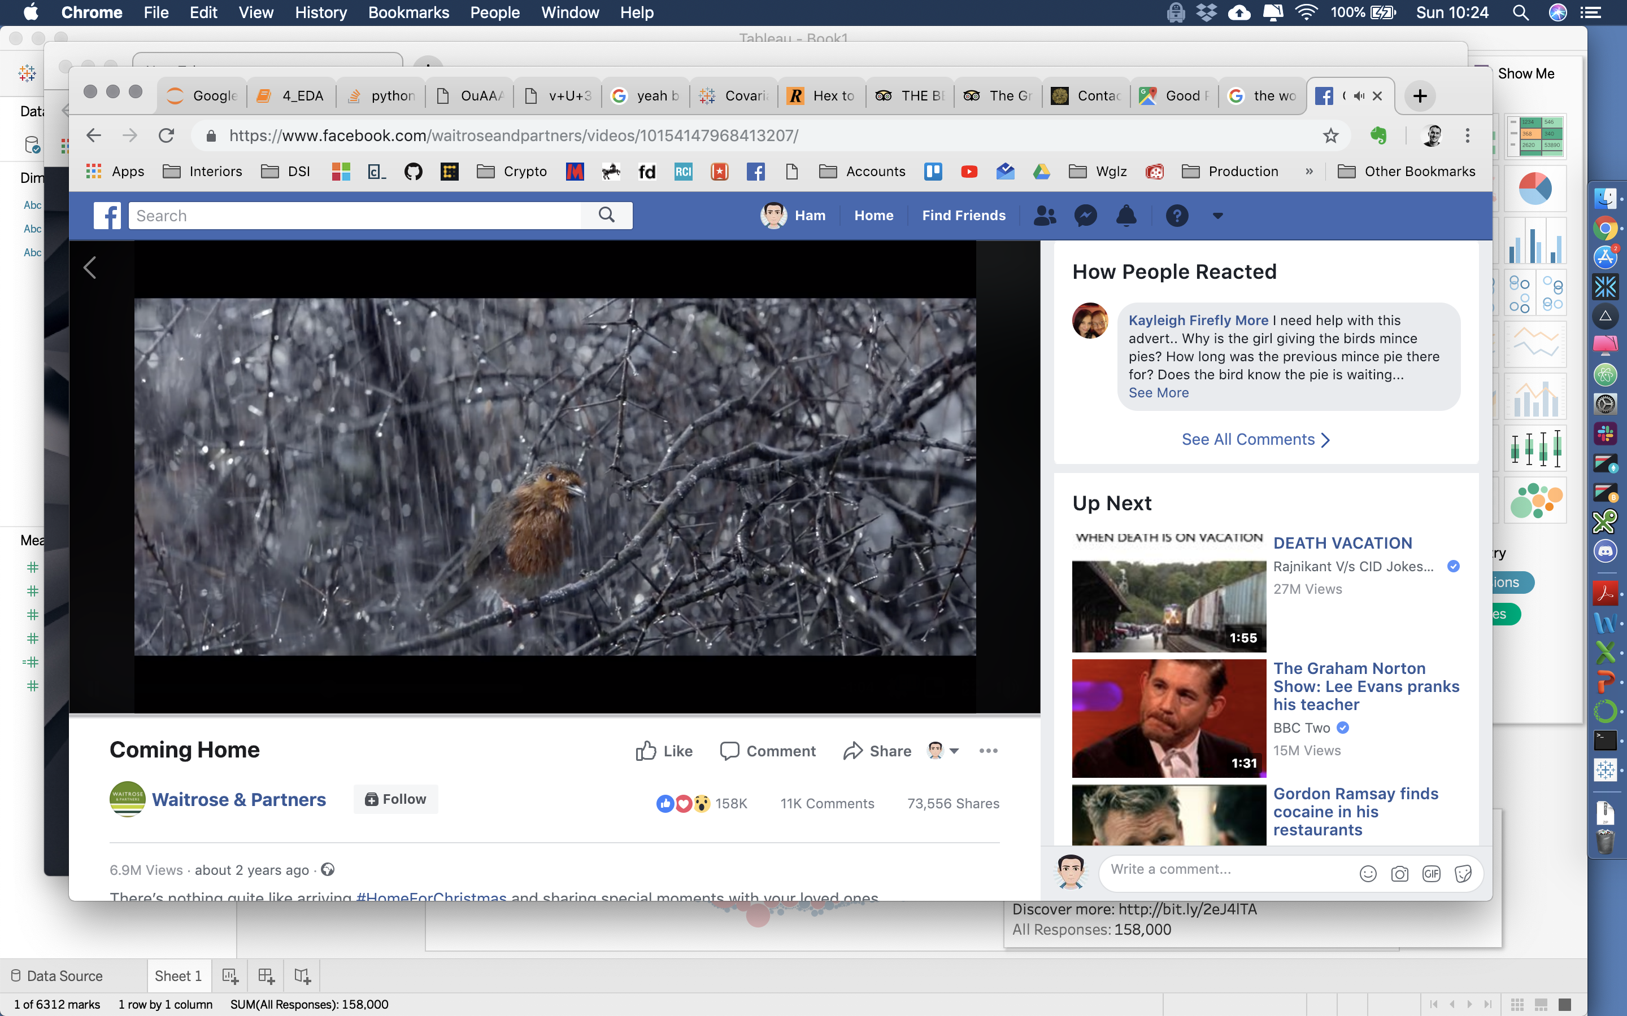
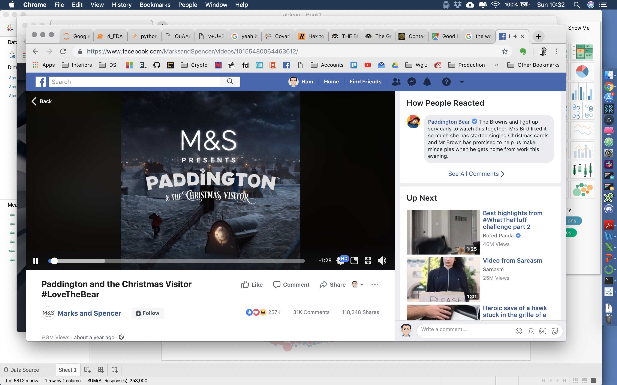
Those outliers are usually videos that are entertaining or that carry an emotional resonance of some kind
Size of circles represents number of shares post received

Slide 26
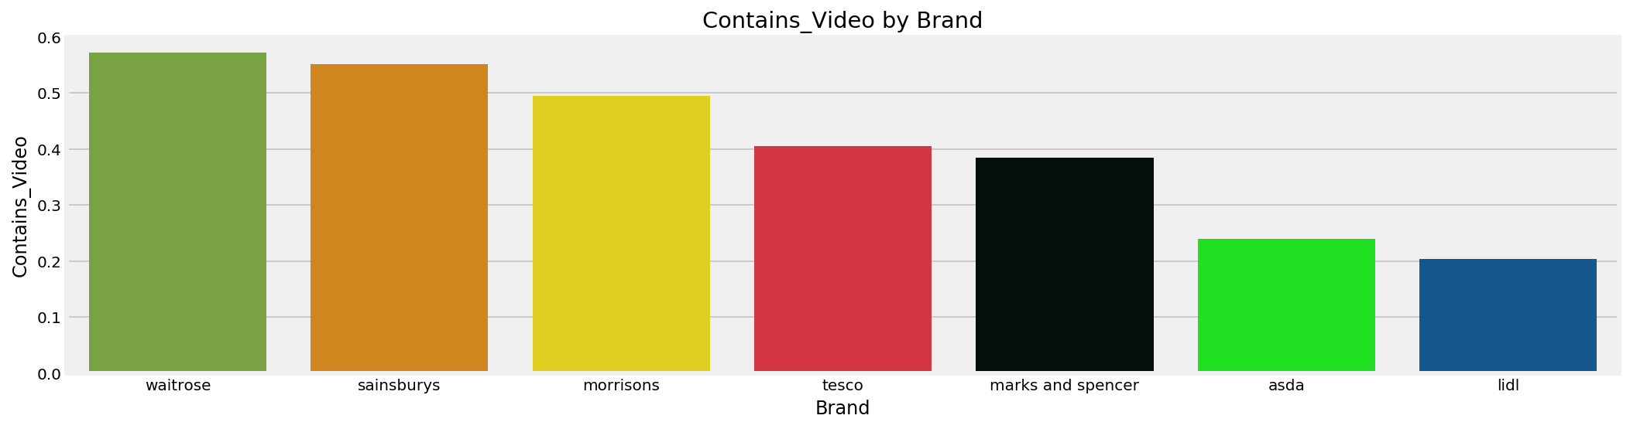
Some brands are far more likely to post videos than others
Does this mean they also get a lot of shares?

Slide 27
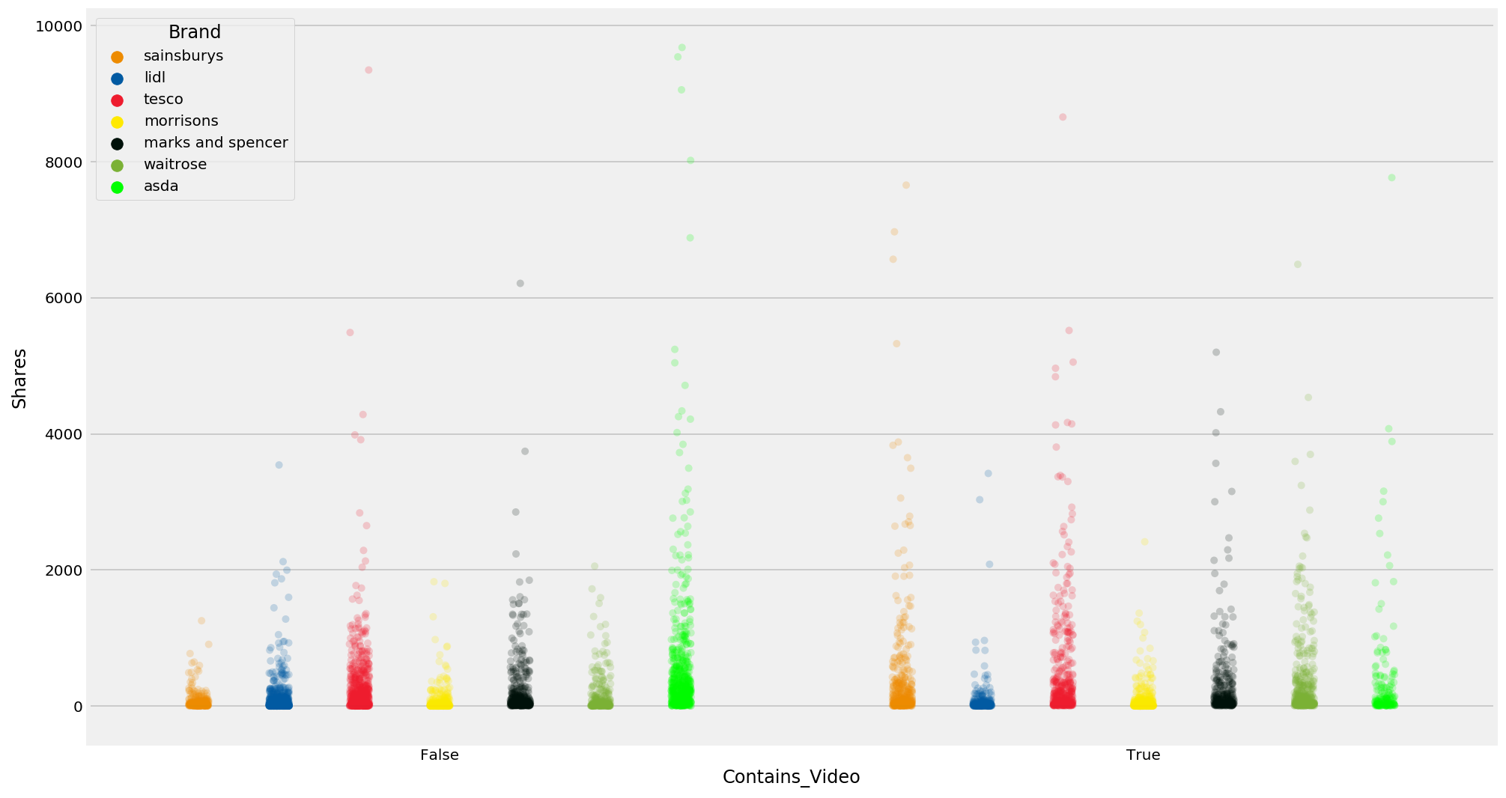
Not in all cases and particularly with ASDA – whose posts without videos consistently get shared more

Slide 28
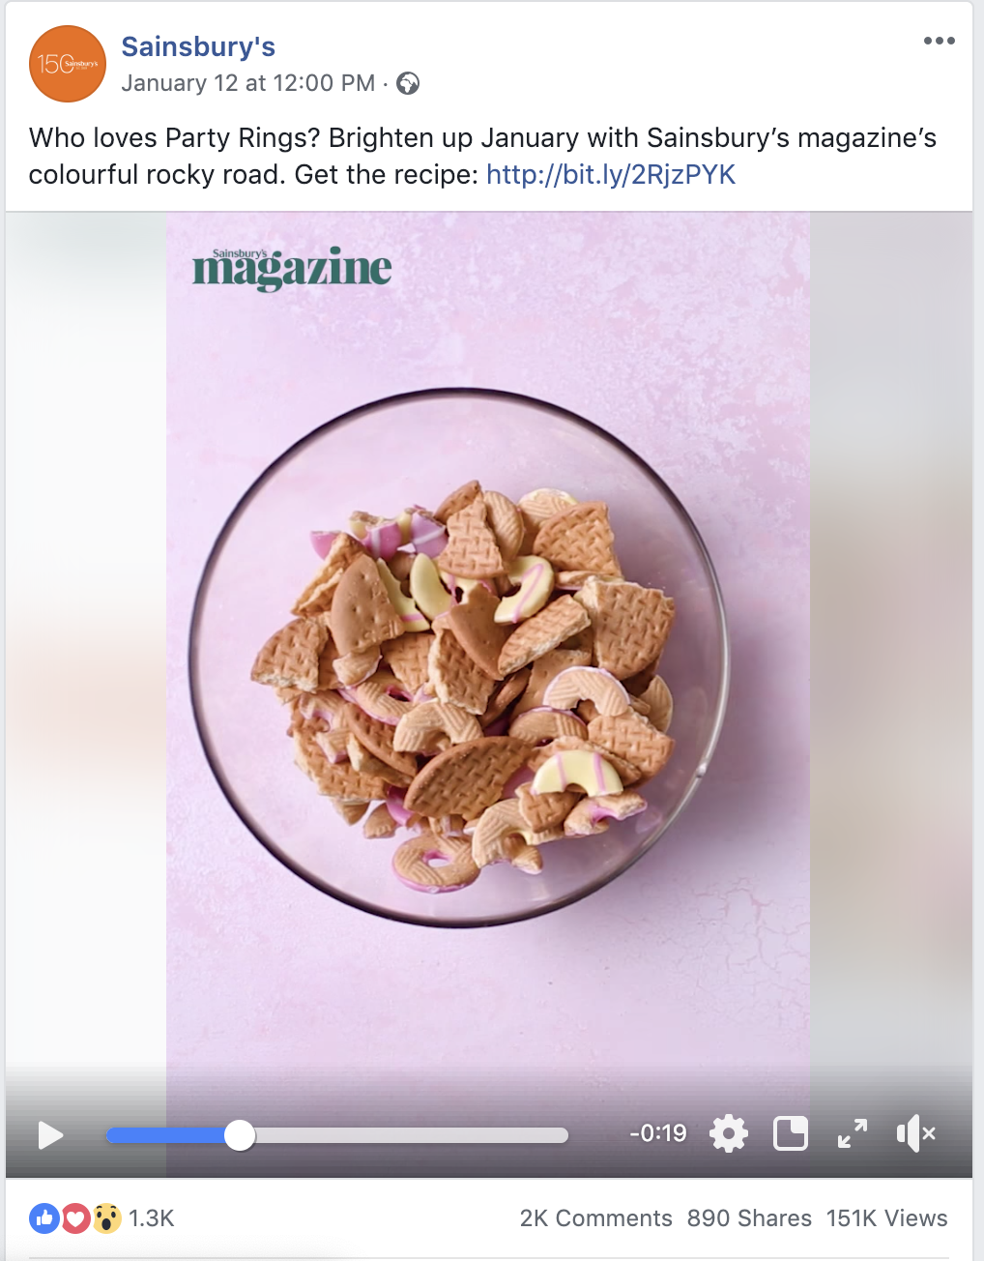
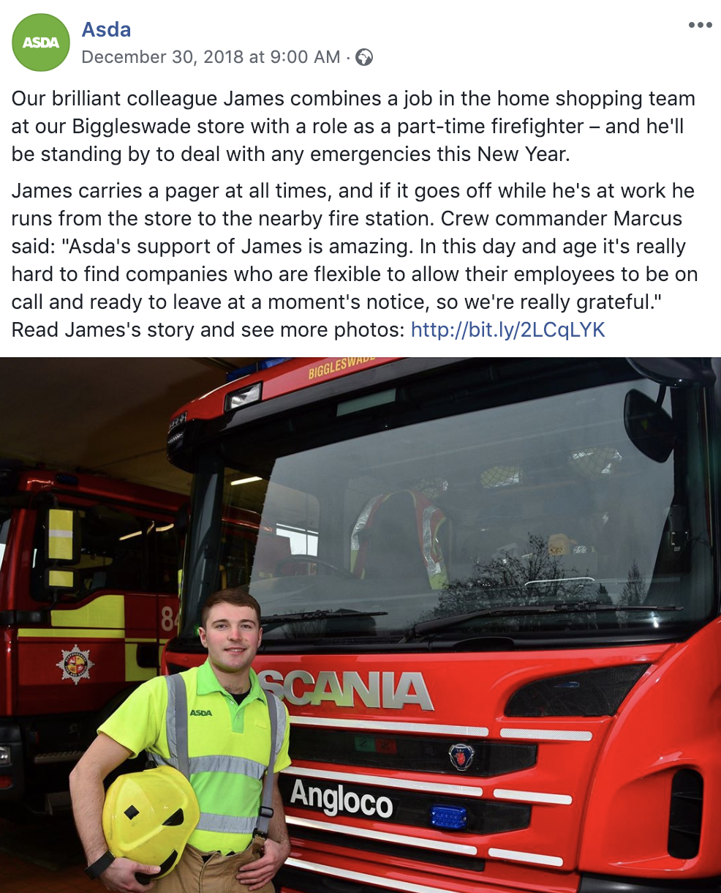
Qualitatively, it feels there is a big difference in what supermarket brands talk about on Facebook
Short. To the point. Food. Recipes.
Wordier.
People. Causes

Slide 29
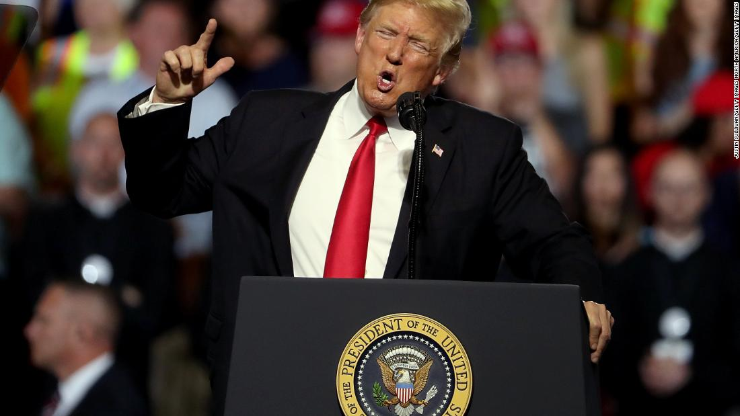
Our choice of words influences our identity

Slide 30
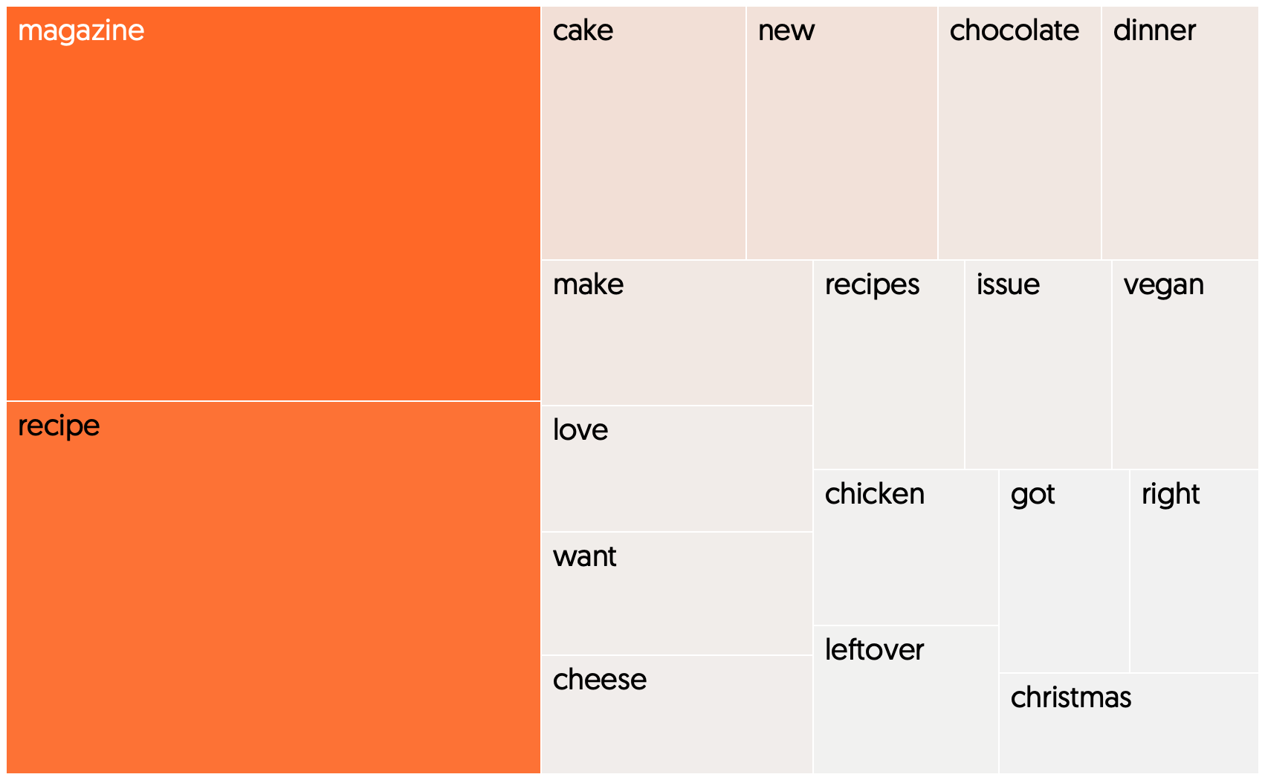
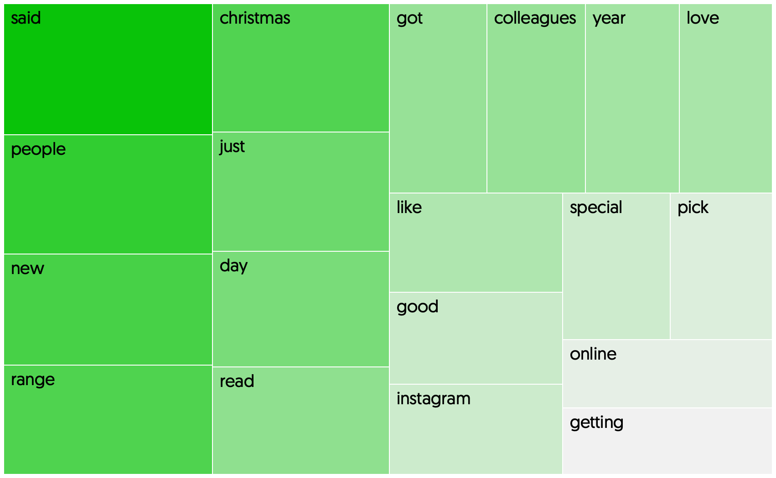
Sainsbury’s talk about their magazine/recipes......less so for ASDA who focus on people and communities
Weighted term frequencies by brand : (TF-IDF) Vectorisation

Slide 31
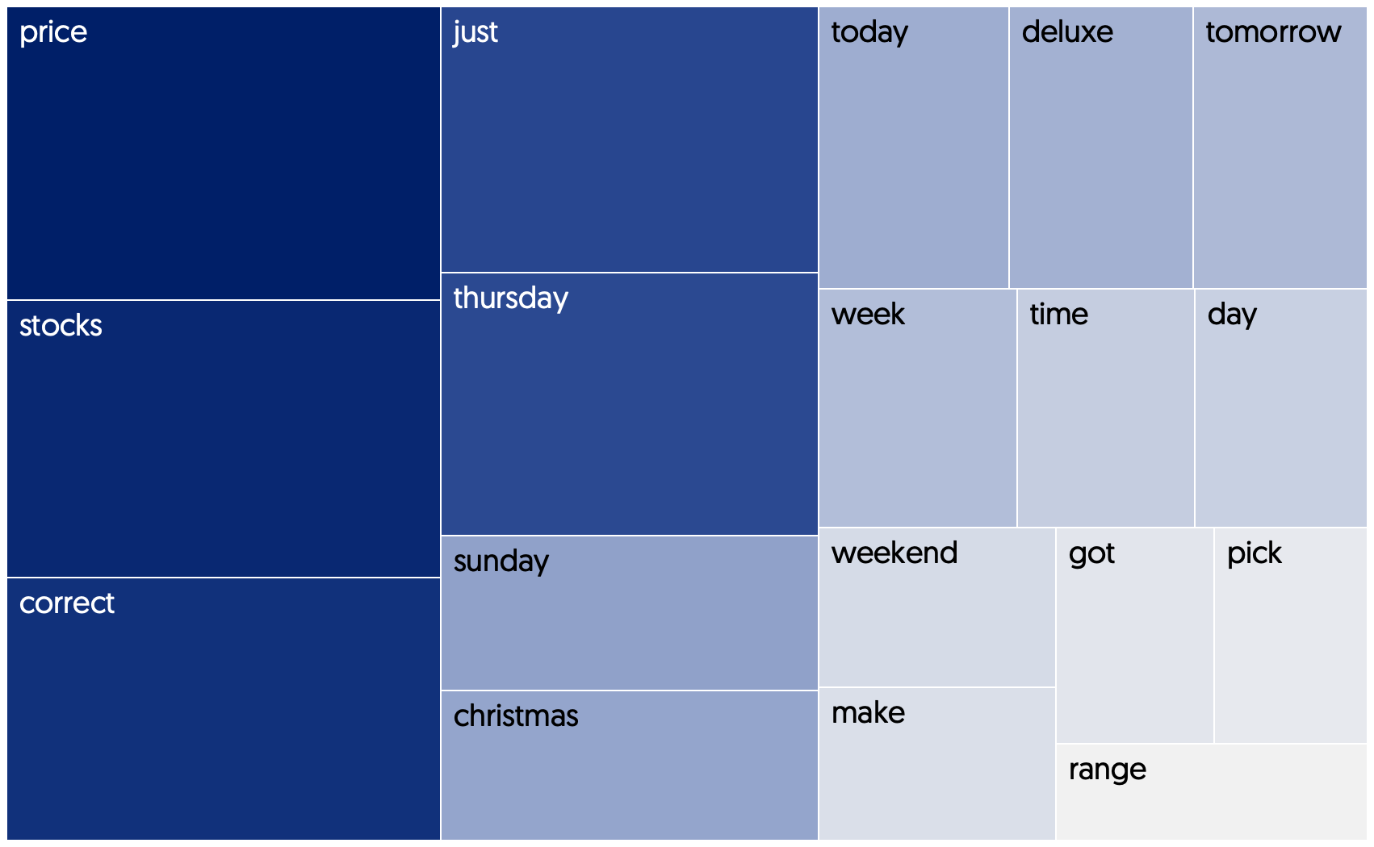
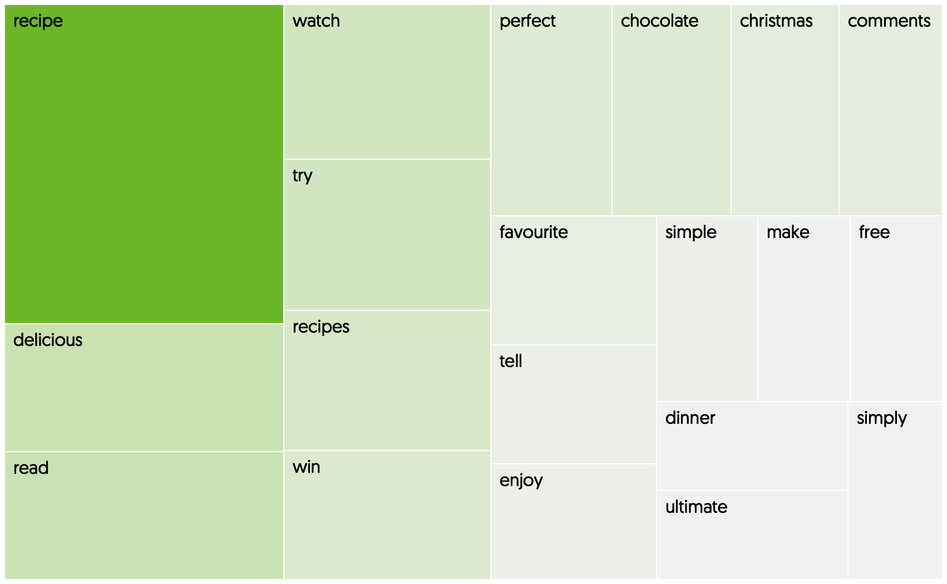
Lidl talk about price and stock availability whereas Waitrose focus on recipes
Weighted term frequencies by brand : (TF-IDF) Vectorisation

Slide 32
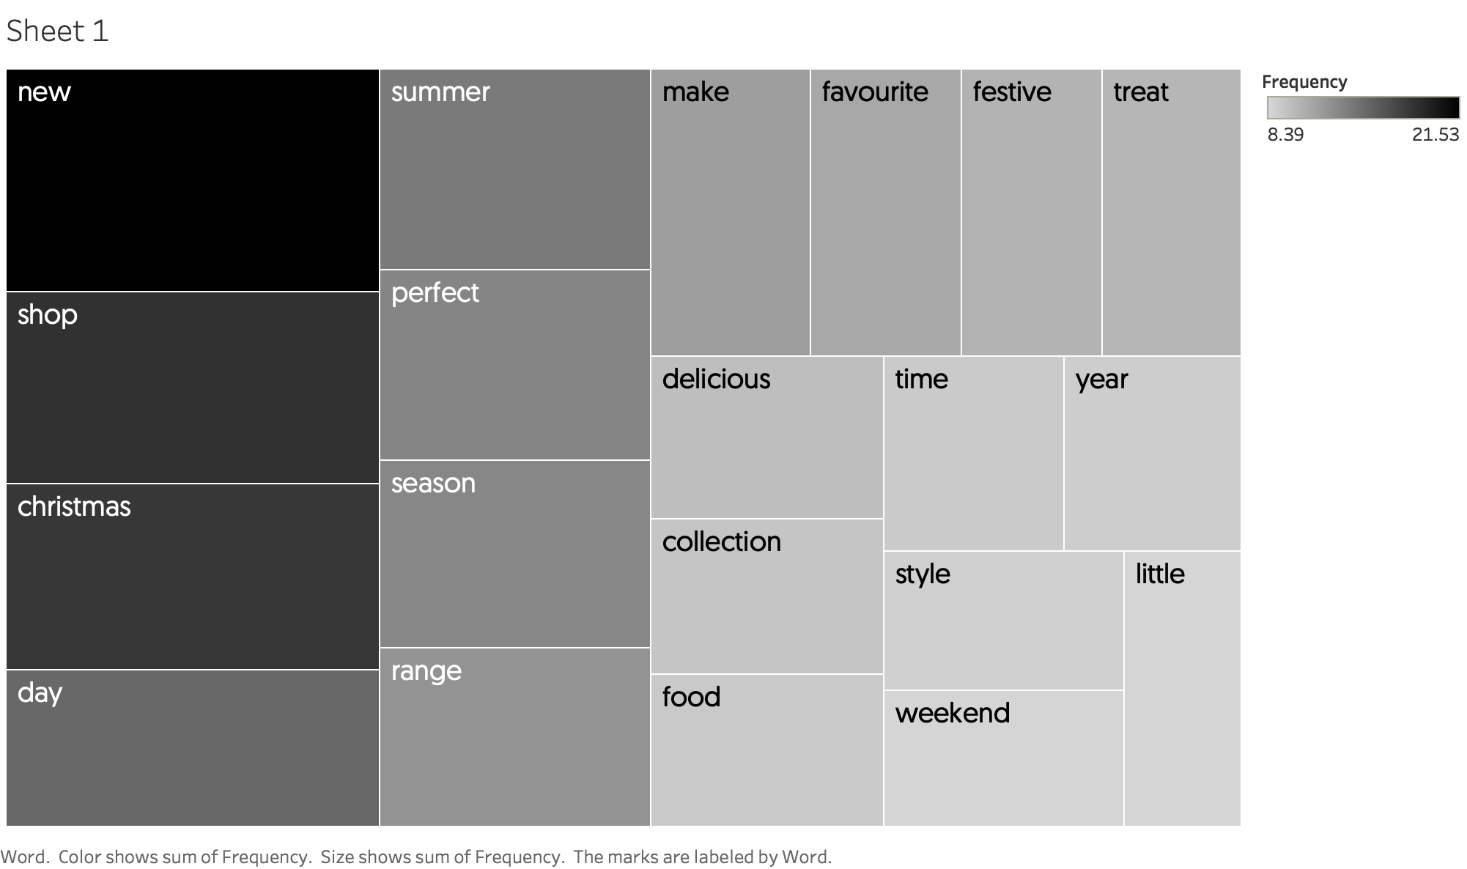
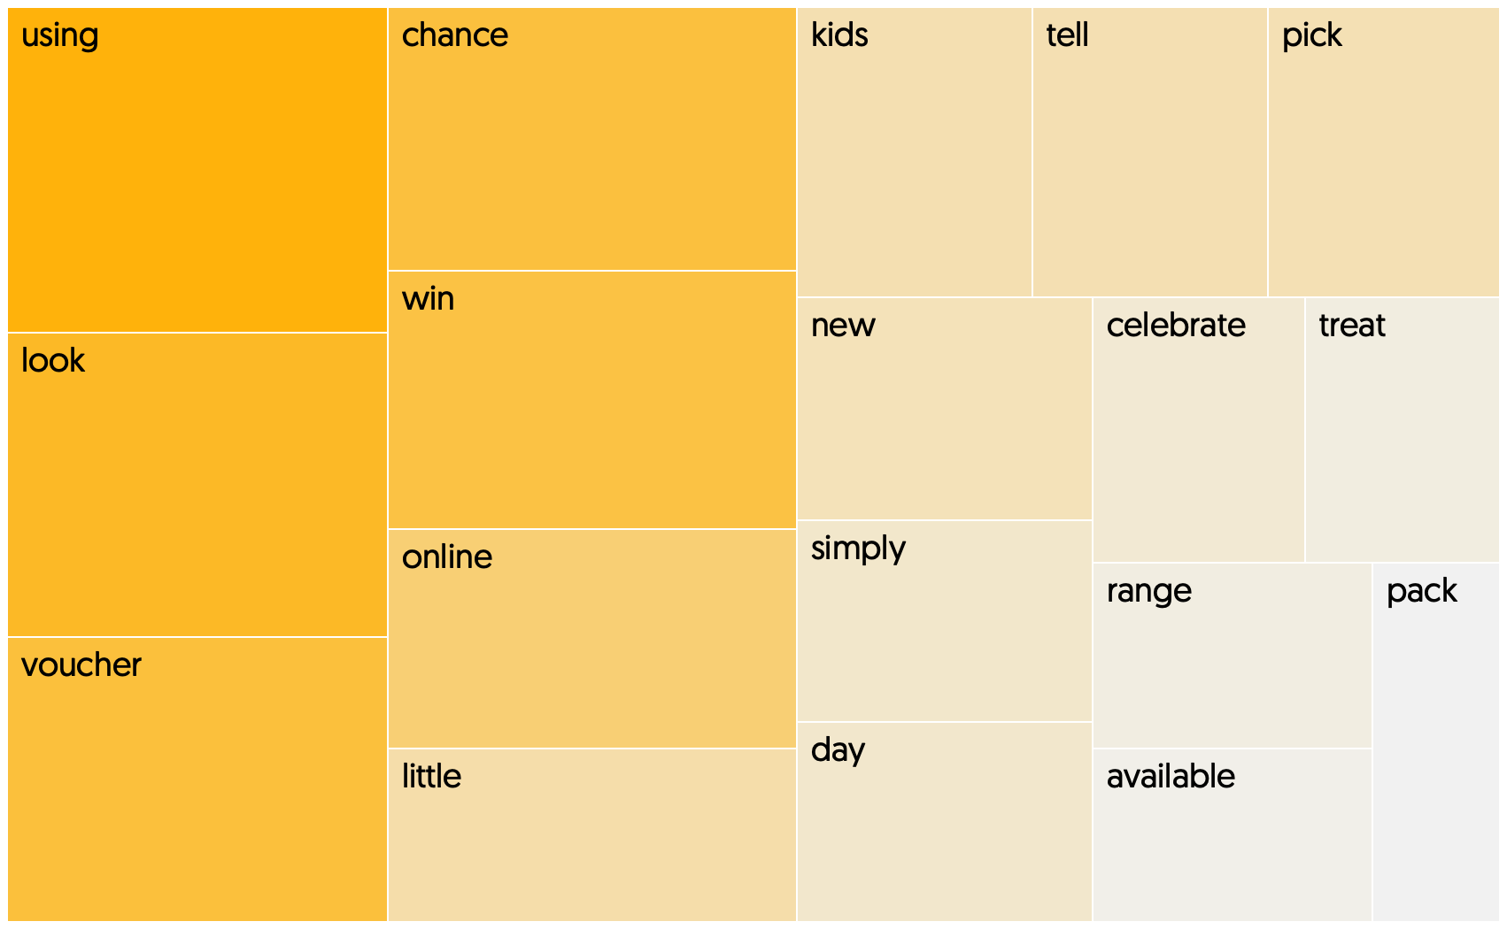
M&S talk about new things to shop for, Morrisons (a bit like Asda), avoid talking about food
Weighted term frequencies by brand : (TF-IDF) Vectorisation

Slide 33
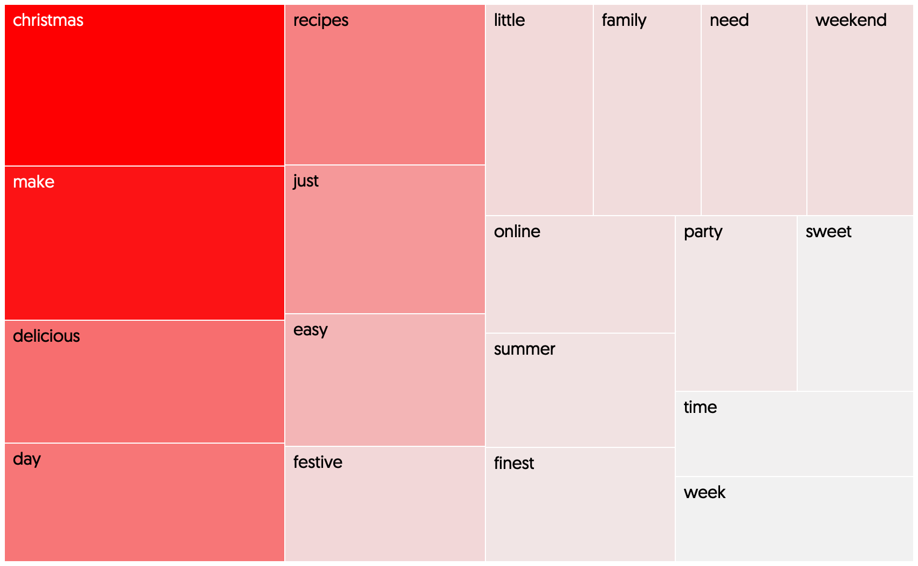
Tesco owns Christmas
Weighted term frequencies by brand : (TF-IDF) Vectorisation

Slide 34
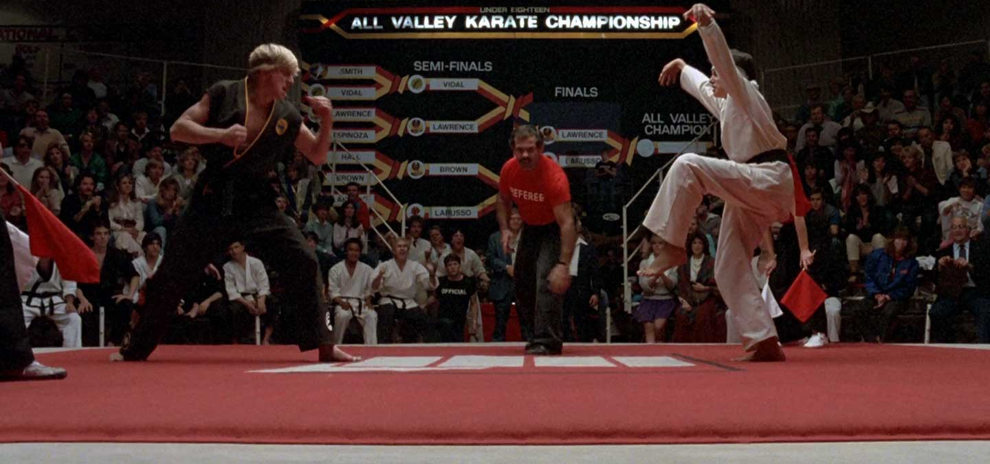
Modelling Approach
Round 1
Performance Optimization
Round 2
Performance Optimization
Finalist Winner
Logistic Regression
(0.692)
KNN
(0.47)
Random Forest Classifier
(0.61)
SVM
(0.69)
Multi Layer Perceptron
(0.68)
Logistic Regression
KNN
Random Forest Classifier
SVM
Multi-Layer Perceptron
Grid Search with 5 fold
Cross Validation
Ensemble
Voting Classifier
‘Frankenstein’ Classifier
0.699
Metric : classifier accuracy score on
Test/unseen data

Slide 35

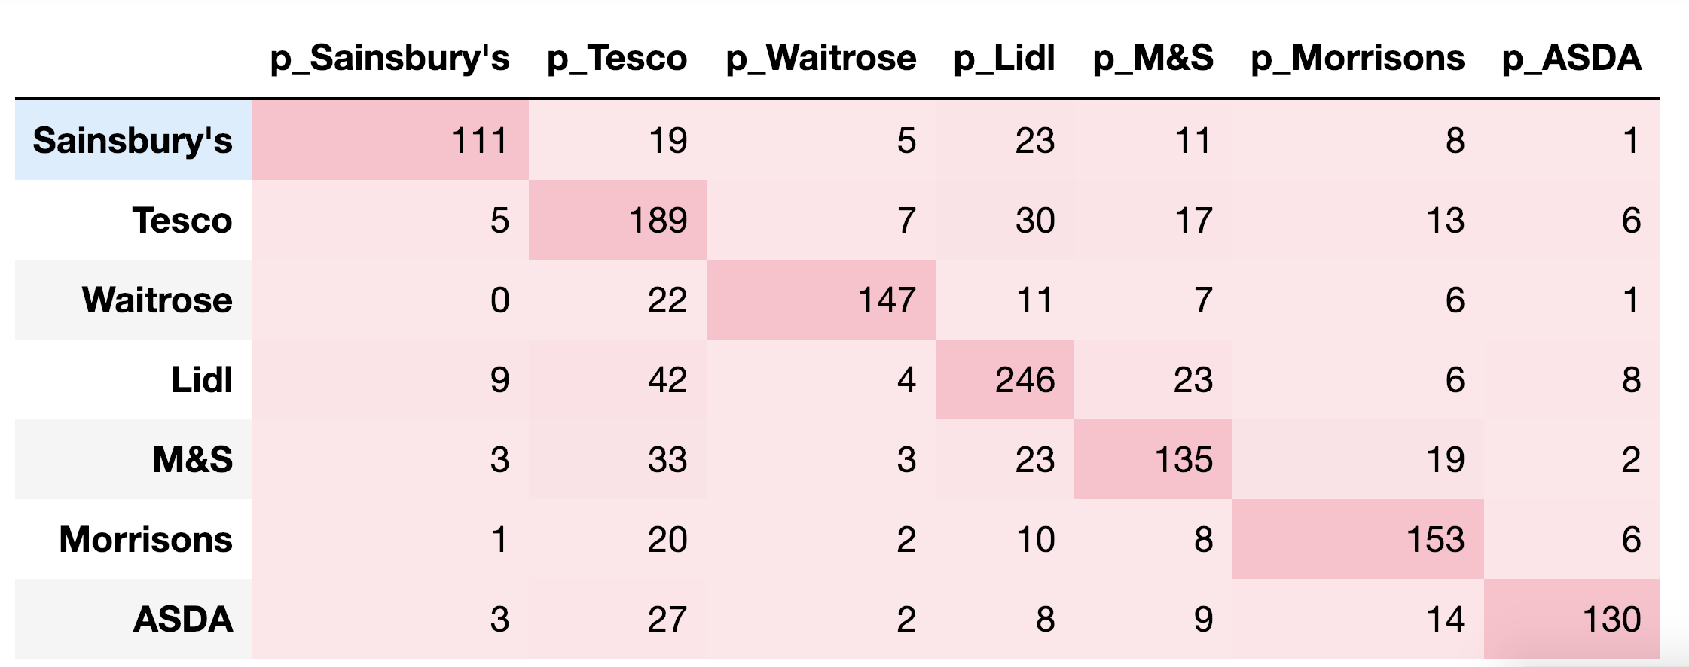
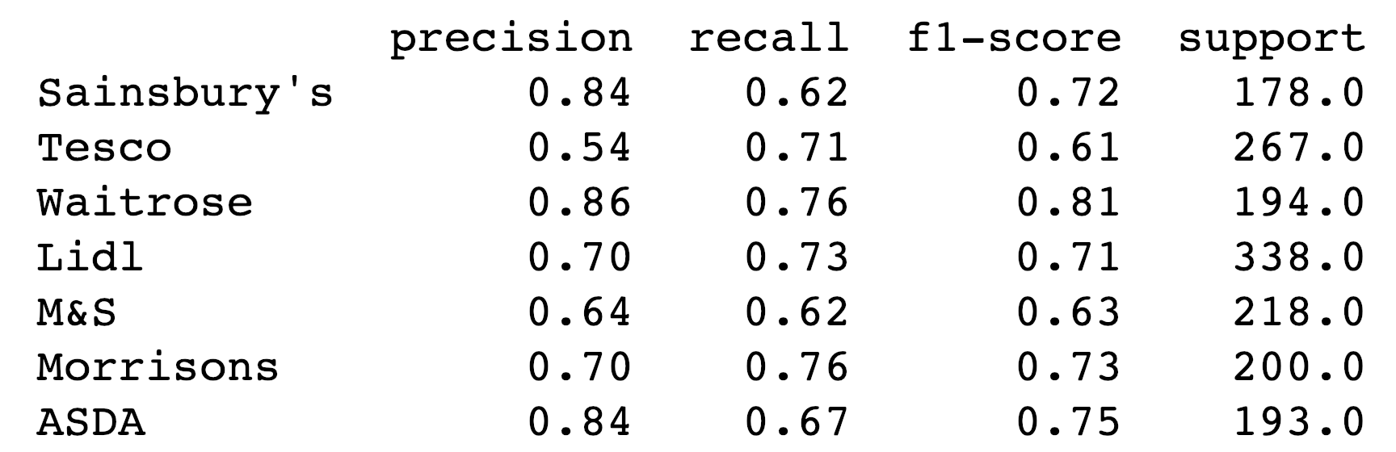
Classifier Evaluation : Confusion matrix
High precision with Waitrose, Sainsbury’s and ASDA i.e. when our model predicted these brands over 80% of the time it was correct
Poorer performance with M&S and Tesco

Slide 36
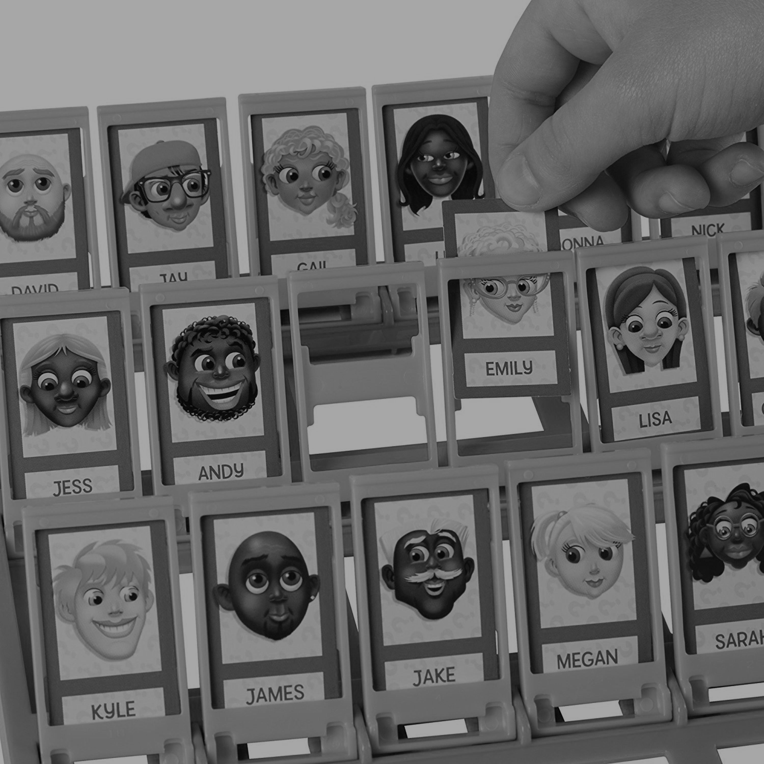
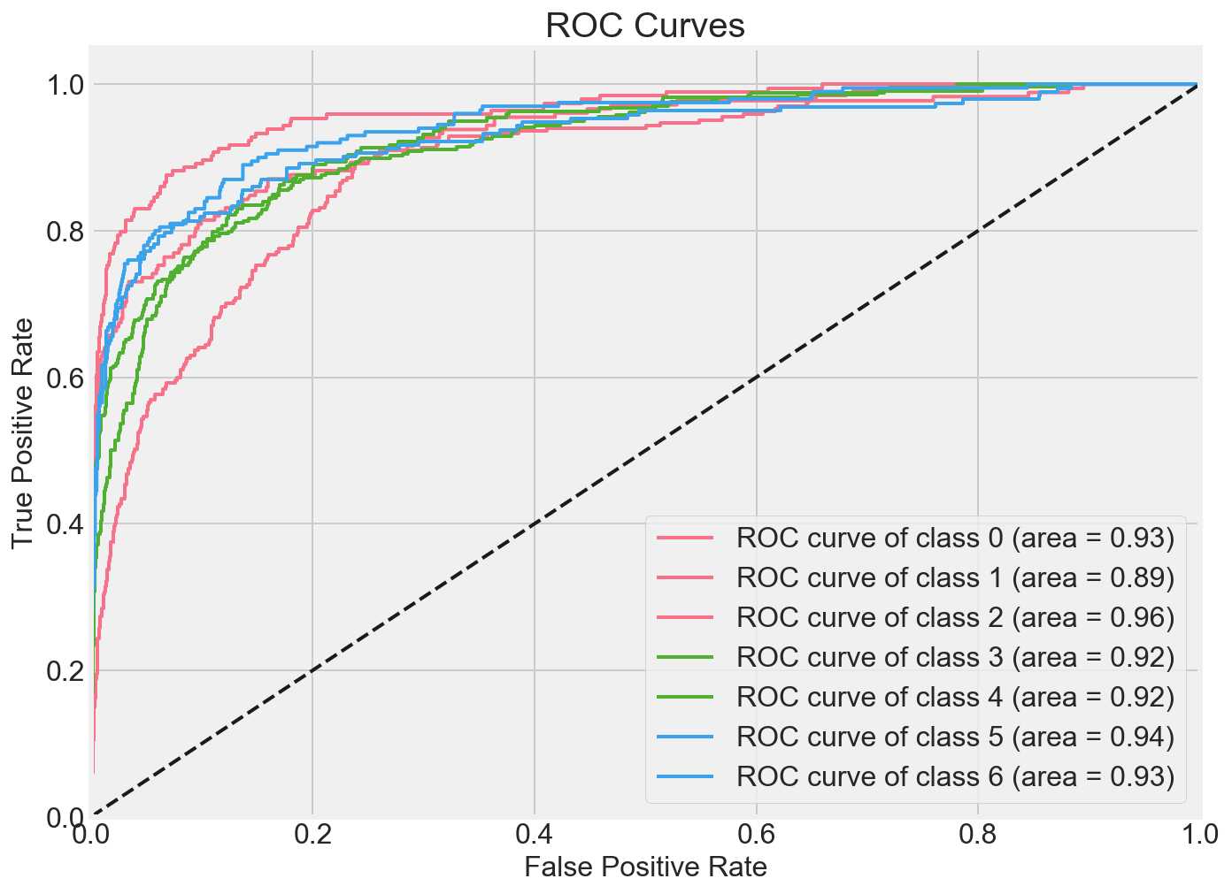
Classifier Evaluation : ROC-AUC
ROC-AUC Curve Interpretation
All classes (brands) have high ROC-AUC scores which implies that for most of our brands, our model has been able to provide strong separability between true positives for that brand (i.e. predicting 'Waitrose' and it being brand 'Waitrose') and true negatives (i.e. correctly predicting it as something else other than Waitrose).
The only brand that has slightly weaker AUC scores is Tesco - this implies that the proportion of false positives and false negatives for Tesco is higher i.e. that our model sometimes incorrectly classed a post as Tesco when it was Morrisons (False Positive) and should have classed a post as Tesco, when it classed it as something else (e.g. Morrisons)
Area under ROC curve (ROC-AUC):
Sainsbury's: 0.93
Tesco: 0.89
Waitrose: 0.96
Lidl: 0.92
M&S: 0.92
Morrisons: 0.94
ASDA: 0.93

Slide 37
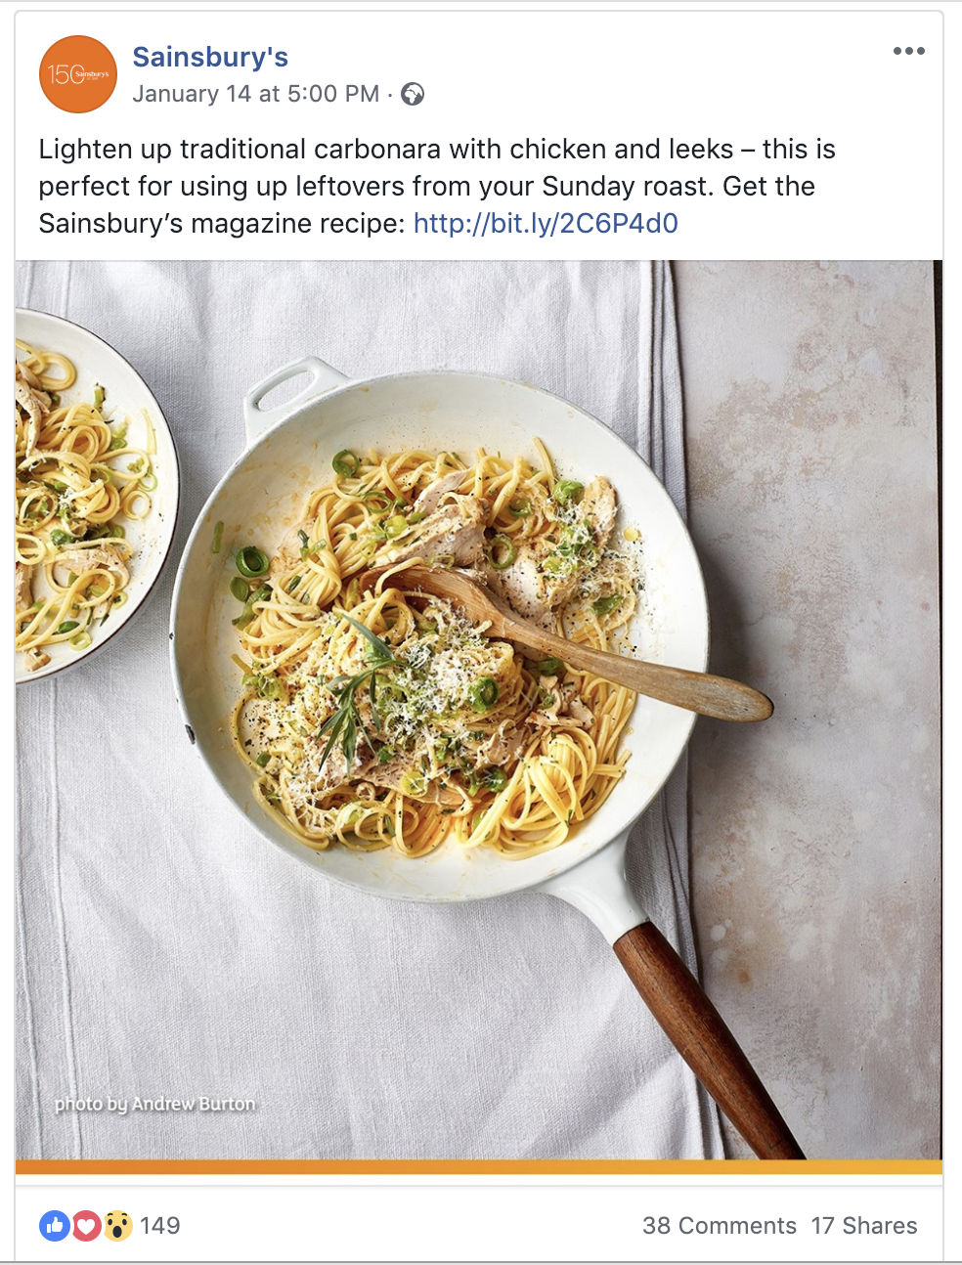
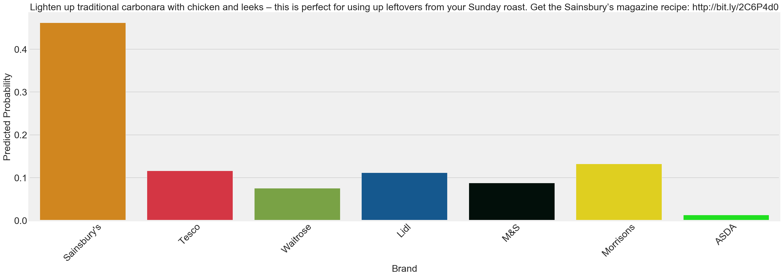
Testing the model on new data
Note – there is a pre-processor in the pipeline that removes all branding cues before the model makes any predictions !

Slide 38
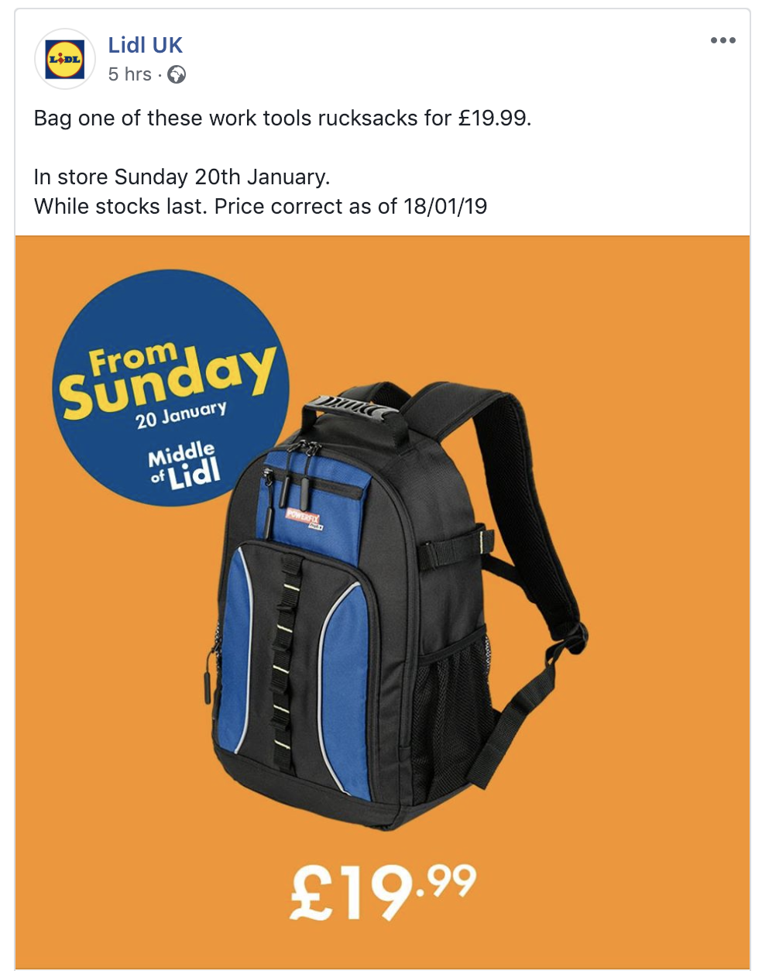
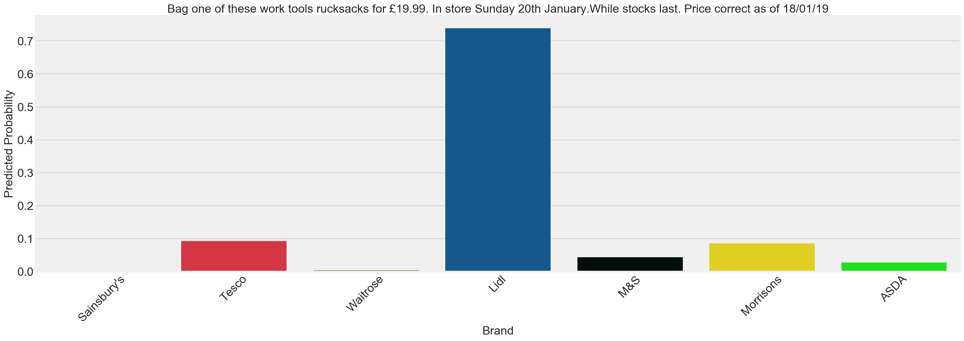
Testing the model on new data

Slide 39

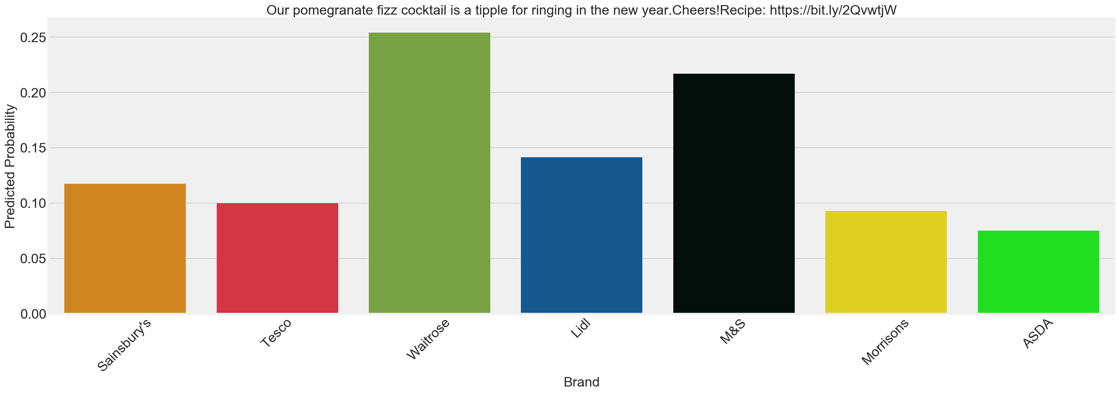
Testing the model on new data

Slide 40
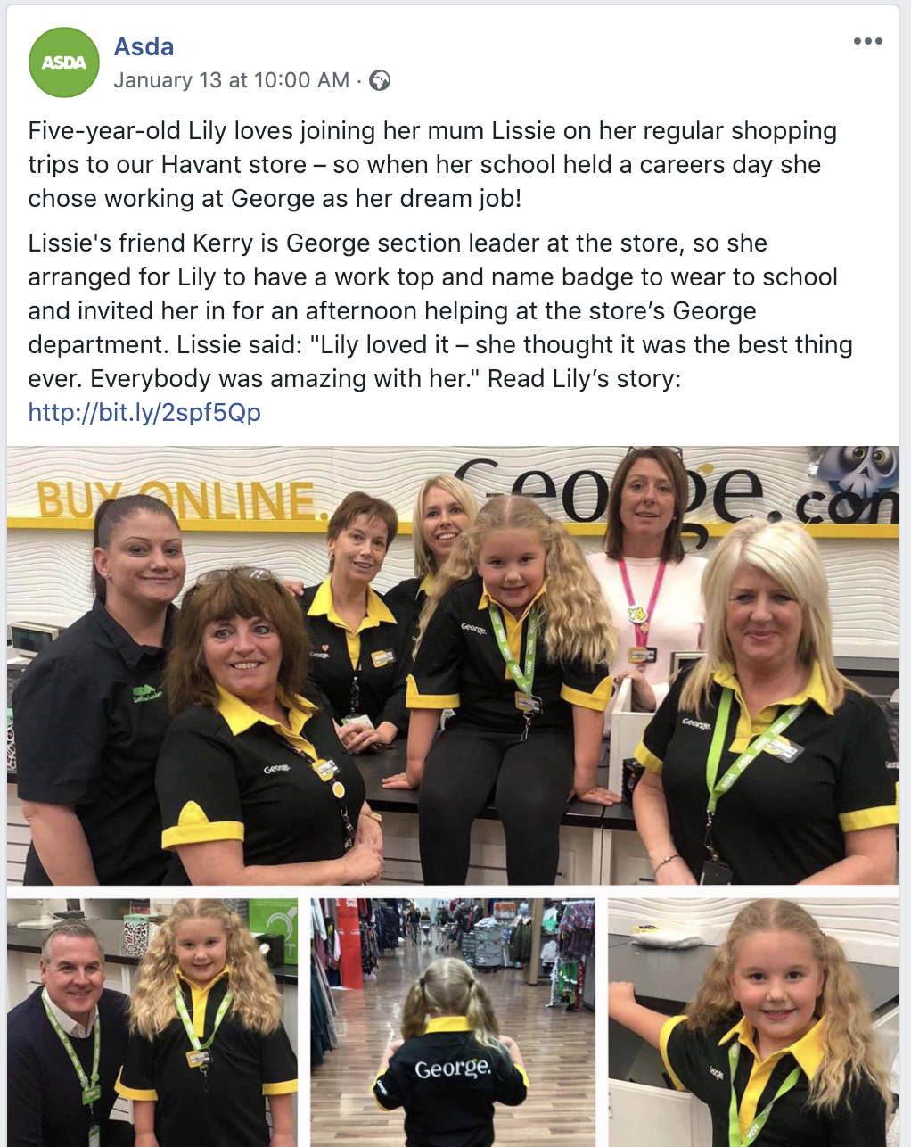
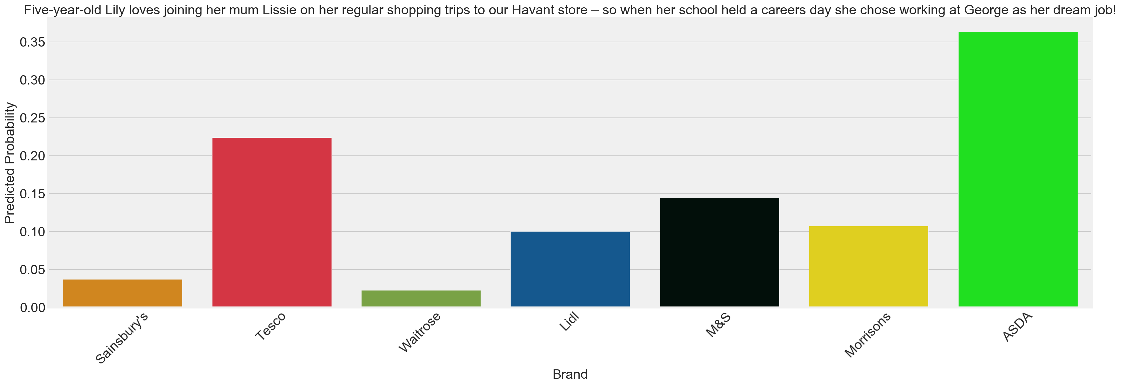
Testing the model on new data

Slide 41

IMPLICATIONS

Slide 42
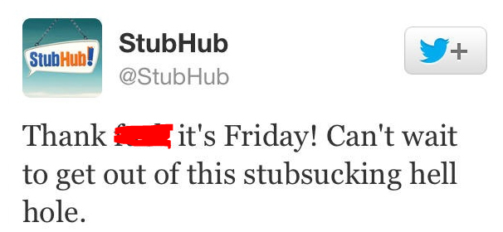
Sense checking your social content
I have no doubt that most social media managers know what they’re doing, but a little sense check never hurt anyone

Slide 43
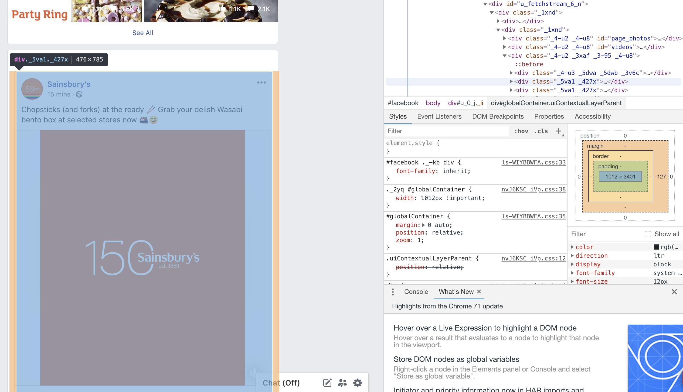
Transferability to other categories
Facebook pages are (mostly) built with consistent html. Furthermore, the social infrastructure across brands (likes, comments, shares) is also consistent for all brands.
So in terms of acquiring new data for other categories and brands, it would be fairly straightforward to replicate this project again for anything else you can think of

Slide 44

Risks & Limitations
It’s (not) been emotional
Word counts - even TF-IDF – don’t capture sentiment very well.
Future iterations of content analysis could look at sentiment and see if emotion is a useful predictor?
Neglected Features
Many features were acquired, that although were helpful for EDA, weren’t used in any modelling.
Could we look at regression models and see what kinds of content predict social ‘success’
Neglected Channels
There’s more to social media than Facebook.
Could we integrate data from Twitter, Instagram, Snapchat?

Slide 45
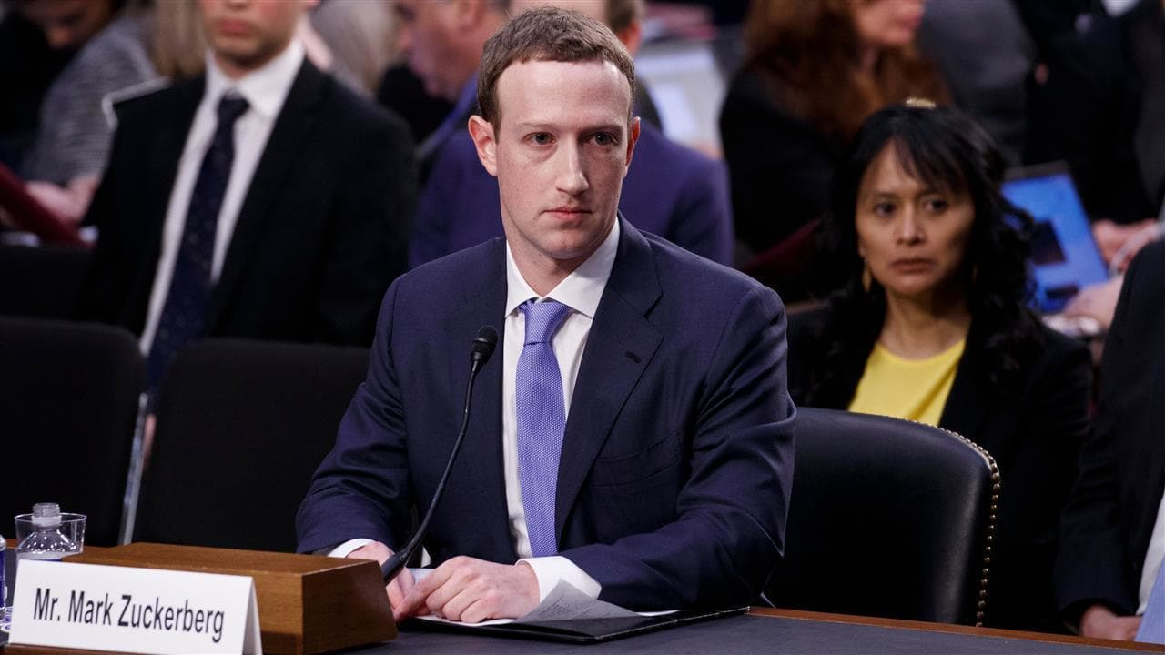
QUESTIONS?

